Slide 1
Term Project
Khadisah Nicholson
Whitney Davis
Sekuan Modibo
Dereck Murphy

Slide 2
Mapping Whitney Davis and Sekuan Modibo

Slide 3
Problem Statement
This system will generate student outcomes vs. criteria grid and provide useful information about whether candidates have reached important learning goals and about the progress of each candidate in their programs.

Slide 4
Assumptions Constraints
System accessible 99% of the time
System will be secure with access control
System will allow faculty to compare student’s outcomes with criteria grid.

Slide 5
Feasibility Analysis
Technical: System is able to provide necessary infrastructure to provide the subsystem to match its needs and capabilities.
Economic: N/A
Operational: Faculty

Slide 6
Faculty outcomes Khadisah Nicholson and Dereck Murphy

Slide 7
Problem Statement
To allow faculty to generate and compare student outcomes based on the abet criteria

Slide 8
Assumptions/Constraints
Assumptions:
Faculty will utilize the software outcomes using their own personal ID and password
The outcomes will be running at all time
The outcomes will be updated properly
Constraints:
Each faculty will have unique log in information
The system may experience slowness if multiple faculty members are trying to access
Database will need to be updated and connected

Slide 9
Feasibility Analysis
Technical: Appropriate hardware will be needed to utilize the Faculty outcomes efficiently. The computers and other devices will need to be maintained and updated by our staff periodically. Webpages will need to be updated and working properly at all times.
Economic: Open source software has been implemented. This will reduce the cost for software tremendously. The computers will still need to be maintained and updated periodically. This will reduce the possibility of computer failure, which may cost the organization a substantial amount.
Operational: Faculty will need to be trained and meet occasionally to discuss and understand the faculty outcomes. The faculty will need appropriate training on how to utilize the outcomes to help compare and generate the student outcomes..

Slide 10
Evaluation Criteria
Function/Rating | 1 | 2 | 3 | 4
outcomes: Accessibility | outcomes cannot be accessed by any faculty member | outcomes is accessible, but not 24 hours 7 days a week. | outcomes is accessible but has minor bugs. | outcomes is accessible at all times and each registered Faculty has access.
outcomes: Efficiency | outcomes isn’t maintained or updated periodically. | outcomes is updated periodically, but outcomes isn’t maintained. | outcomes is maintained, but updates are not properly pushed. | outcomes is maintained and updated periodically.
outcomes: Utilization | outcomes is not user friendly. Hard to use. | outcomes has appropriate information, but hard for Faculty to use. | outcomes is easy for Faculty to use, but too much information to sort through. | outcomes information is simple and user friendly.

Slide 11
Requirements Matrix
Requirements Matrix: Faculty outcomes
 | Input | Processing | Output | Storage | Control/Security
Software | Information from Faculty. | Compare information against criteria | Student outcomes. | CPU or any other device faculty may use. | Software should be installed on approved PCs for faculty.
Hardware |  | Validate all system requirements are up to date. | Hard copy of student outcomes as requested. |  | Password Encryption
Data | Data collected from faculty |  |  | Database | Secured Database
Information |  | Data is analyzed and compared against the criteria | Simplified but informative information for student outcomes. | Updated Database | Secured Database
People |  |  | Student outcome is used to map the student’s courses.

Slide 12
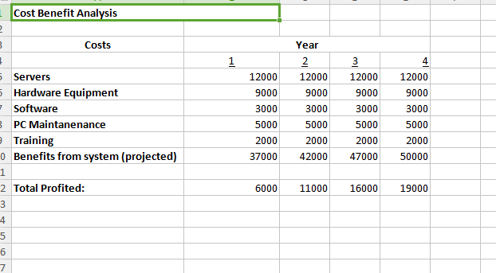
Cost Benefit Analysis

Slide 13
Mapping with student outcomes
Derrick Murphy

Slide 14
Problem Statement
This system will associate students outcomes to abet criteria, providing progress of candidates in select programs.

Slide 15
Assumptions Constraints
Assumptions:
Student outcomes of the criteria being compared
The system will secure
System accessible 99% of time
Constraints:
Each faculty will have unique log in information
High volume of storage may reduce system speed
Database storage compacity

Slide 16
Feasibility Analysis
Technical:
Suitable data that is able to process. Updates accordingly to system requirements. Minimal database updates and should have marginal downtime.
Economic:
N/A
Operational:
Knowledge requirements of the mapping system by operating staff.

Slide 17
Evaluation Criteria
Function/Rating | 1 | 2 | 3 | 4
Outcomes: Accessibility | Outcomes cannot be generated by any faculty member. | outcomes is accessible, but not 24 hours 7 days a week. | outcomes is accessible but missing some criteria. | outcomes is accessible at all times and each outcome’s criteria is all filled.
Outcomes: Efficiency | outcomes isn’t generated or mapped to criteria. | Outcomes partially generated, some criteria mapped. | outcomes generated and maps some criteria. | outcomes is generated and maps with criteria.
Outcomes: Utilization | outcomes incorrectly scaled or generated. | outcomes partially scaled correct, missing some criteria. | outcomes is scaled correct but not all criteria. | outcomes information is scaled correct.

Slide 18
Requirements Matrix: Mapping with student outcomes
 | Input | Processing | Output | Storage | Control/Security
Software | Information from Faculty | Check for criteria update | Outcomes processed |  | Password Encrypted
Hardware |  |  | Hard copy of student outcomes as requested. |  | Password Encryption
Data | Data collected from candidates | Verify candidate data against criteria |  | Database | Secured Database
Information |  | Analysis of data | Candidate outcome mapped to criteria. | Updated Database | Secured Database
People | Faculty |  | Faculty Student | Faculty | ID system

Slide 19
Cost/Benefit Analysis

Slide 20
Feasibility Analysis: Faculty Portal
Technical: Appropriate hardware will be needed to utilize the Faculty Portal software efficiently. The computers and other devices will need to be maintained and updated by our administrators periodically. Webpages will need to be updated and working properly at all times.
Economic: Open source software has been implemented. This will reduce the cost for software tremendously. The computers will still need to be maintained and updated periodically. This will reduce the possibility of computer failure, which may cost the organization a substantial amount.
Operational: Faculty will need to be trained and meet occasionally to discuss and understand the faculty outcomes. The faculty will need appropriate training on how to utilize the outcomes to help compare and generate the student outcomes.

Slide 21
Evaluation Criteria: Faculty Portal
Function/Rating | 1 | 2 | 3 | 4
outcomes: Accessibility | outcomes cannot be accessed by any faculty member | outcomes is accessible, but not 24 hours 7 days a week. | outcomes is accessible but has minor bugs. | outcomes is accessible at all times and each registered Faculty has access. No bugs in software.
outcomes: Efficiency | Software not maintained or updated periodically. | Software updated periodically, but not maintained. | Software is maintained, but updates are not properly pushed. | Software is maintained and updated periodically.
outcomes: Utilization | Software not user friendly. Hard to use. | Software has appropriate information, but hard for Faculty to use. | Software is easy for Faculty to use, but minor issues (slowness) | Software is simple and user friendly.

Slide 22
Requirements Matrix: Faculty Portal
Requirements Matrix: Faculty outcomes
 | Input | Processing | Output | Storage | Control/Security
Software | Information from Faculty. | Compare information against criteria | Student outcomes. | CPU or any other device faculty may use. | Software should be installed on approved PCs for faculty.
Hardware |  | Validate all system requirements are up to date. | . |  | Password Encryption
Data | Faculty personal ID |  |  | Database | Secured Database; Accessed by specific Faculty
Information |  |  | Information pertaining to the student outcomes and Faculty information. | Updated Database | Secured Database
People |  |  | Student outcome is used to map the student’s courses.

Slide 23
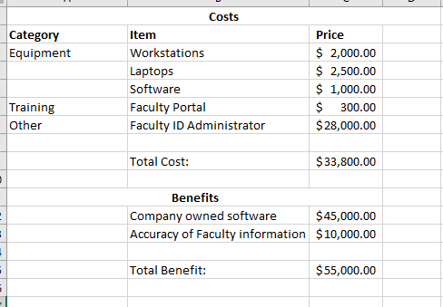
Cost Benefit Analysis: Faculty Portal

Slide 24
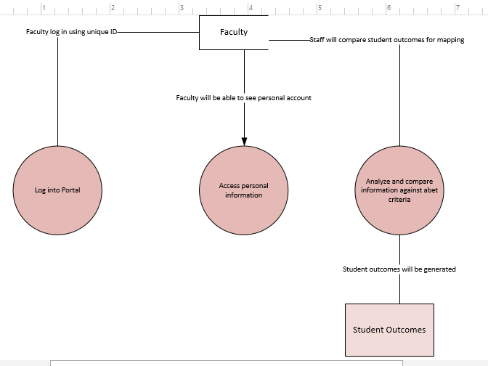
DFD Level 1 – Faculty Portal

Slide 25
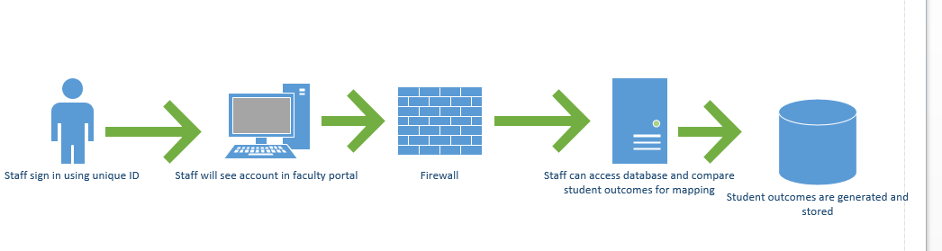
Hardware Diagram : Faculty Portal

Slide 26
Term Project
Khadisah Nicholson
Whitney Davis
Sekuan Modibo
Dereck Murphy

Slide 27
Mapping with Criteria Sekuan Modibo

Slide 28
Problem Statement
This system will generate student outcomes vs. criteria grid and provide useful information about whether candidates have reached important learning goals and about the progress of each candidate in their programs.

Slide 29
Assumptions/Constraints
Assumptions:
Faculty will utilize the software outcomes using their own personal ID and password
The outcomes will be running at all time
The outcomes will be updated properly
Constraints:
Each faculty will have unique log in information
The system may experience slowness if multiple faculty members are trying to access
Database will need to be updated and connected

Slide 30
Assumptions Constraints
System accessible 99% of the time
System will be secure with access control
System will allow faculty to compare student’s outcomes with criteria grid.

Slide 31
Feasibility Analysis
Technical: System is able to provide necessary infrastructure to provide the subsystem to match its needs and capabilities.
Economic: N/A
Operational: Faculty

